Slide 1

A general approach of transfer learning in computer vision to classify objects in videos
Presented by Kitu Komya
On behalf of Nidhi Tiwari
September 7, 2018

Slide 2
Background
background - overview - goals - workflow - research - implement - visualize - summary - next steps
Computer Vision is a field in which computers are taught to see, identify, and process images the same way humans do
Object Detection locates and identifies objects such as bicycles, humans, or cats
Transfer Learning is a machine learning technique where a model trained on one task is re-purposed on a second, related task
Convoluted Neural Networks (CNNs) are used in object detection

Slide 3
Overview
background - overview - goals - workflow - research - implement - visualize - summary - next steps
Problems
Models can only classify a limited set of classes (perhaps cat and dog, but not aardvark or rhinos)
Creating new models from scratch is time-consuming
Solution
Use transfer learning to classify new objects and to build upon pre-existing models
Impacts
Can detect any type of object quickly
Solution is general and can thus be applied to any situation

Slide 4
Goals
background - overview - goals - workflow - research - implement - visualize - summary - next steps
1
Learn the fundamentals and vocabulary of
Computer Vision
2
Implement
Image Classification algorithms
3
Implement
Object Detection algorithms
4
Combine results with
Transfer Learning to detect objects in videos

Slide 5
Workflow
background - overview - goals - workflow - research - implement - visualize - summary - next steps
Research Implement Visualize
2B
2A
Outputs of a predicted class for an image
1
Image Classification
Learn fundamentals of Computer Vision
3A
3B
Bounding boxes of multiple objects
Object Detection
4A
4B
Transfer Learning using YOLO in Keras
Video of Raccoon Detection compared to YOLO model

Slide 6
Research fundamentals of Computer Vision
1
background - overview - goals - workflow - research - implement - visualize - summary - next steps
About Me
Statistics background in R
Switched from a Bayesian Statistics project to Computer Vision
Zero to Hero? Almost…
Research
Neural Networks
Image Classification (VGG16, InceptionV3, ResNet50, MobileNet)
Object Detection (Mask R-CNN, YOLO)
Transfer Learning (in Keras)

Slide 7
Implementing Image Classification
2A
background - overview - goals - workflow - research - implement - visualize - summary - next steps
Tried a few models of varying sizes, parameters, and top-5 accuracies that were validated from ImageNet dataset that classifies 1000 classes
Model Name | Size | Parameters | Top-5 Accuracy
VGG16 | 528 MB | 138,357,544 | 0.901
InceptionV3 | 92 MB | 23,851,784 | 0.944
ResNet50 | 99 MB | 25,636,712 | 0.929
MobileNet | 17 MB | 4,253,864 | 0.871

Slide 8
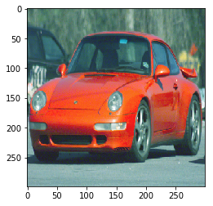
Visualizing Image Classification
2B
background - overview - goals - workflow - research - implement - visualize - summary - next steps
InceptionV3 | ResNet50 | MobileNet
Sports Car (0.78) | Sports Car (0.66) | Sports Car (0.84)
Grille (0.08) | Racer (0.15) | Racer (0.06)
Racer (0.04) | Grille (0.14) | Cab (0.06)
Car Wheel (0.02) | Car Wheel (0.02) | Car Wheel (0.02)
Convertible (0.01) | Convertible (0.01) | Grille (0.01)
All methods resize images...values don’t add to 1.00 because rounding and because top 5 predictions only

Slide 9
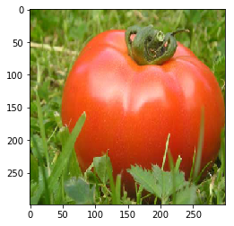
Visualizing Image Classification
2B
background - overview - goals - workflow - research - implement - visualize - summary - next steps
InceptionV3 | ResNet50 | MobileNet
Bell Pepper (0.53) | Croquet Ball (0.21) | Macaw (0.18)
Hip (0.08) | Bell Pepper (0.11) | Hip (0.16)
Pot (0.01) | Zucchini (0.05) | Croquet Ball (0.14)
Croquet Ball (0.01) | Agaric (0.05) | Boxer (0.08)
Balloon (0.01) | Spaghetti Squash (0.04) | Snail (0.06)
Tomato not a labelled class...at least low probability scores, but still...need transfer learning!

Slide 10
Implementing Object Detection
3A
background - overview - goals - workflow - research - implement - visualize - summary - next steps
Image Classification only detects one object per image
Most images are bounded by multiple objects
With huge help of Gaston Bizel, implemented YOLO (You Only Look Once) detection in Keras
YOLO divides input into a square grid
Makes a prediction on each grid
Makes a predicted bounding box on each grid
Need training data with bounding boxes
Works well because it’s generalized and fast

Slide 11
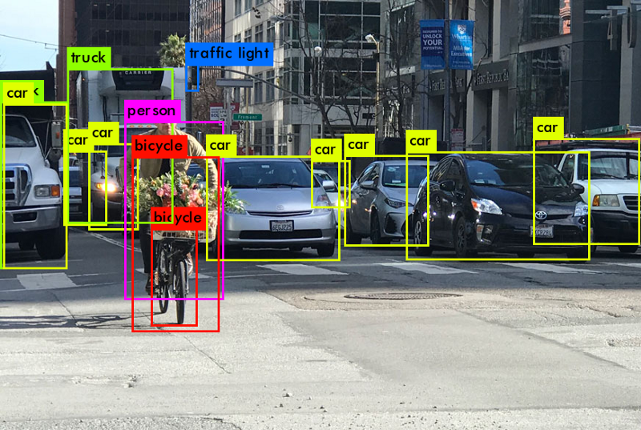
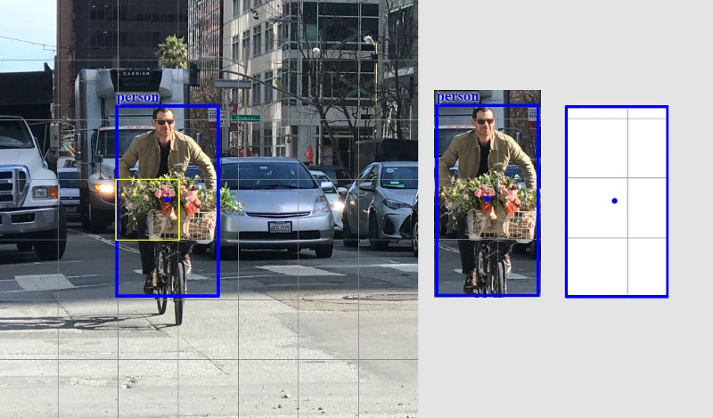
Visualizing Object Detection
3B
background - overview - goals - workflow - research - implement - visualize - summary - next steps
Will make prediction grid by grid...hence need training data that is labelled as such
YOLO can predict multiple objects
Notes:
https://medium.com/@jonathan_hui/real-time-object-detection-with-yolo-yolov2-28b1b93e2088

Slide 12
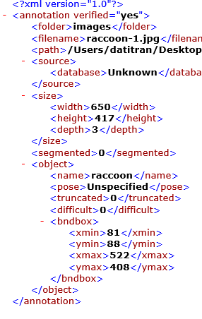
Implementing Transfer Learning
4A
background - overview - goals - workflow - research - implement - visualize - summary - next steps
Build upon YOLO detection by teaching model to identify new classes
Building model from scratch very time-consuming, so using layers of YOLO’s pretrained weights until last one
For demo, using Raccoon detection because found labelled dataset of bounding boxes
Can apply this general technique to any object (spiders, phones, donuts)

Slide 13
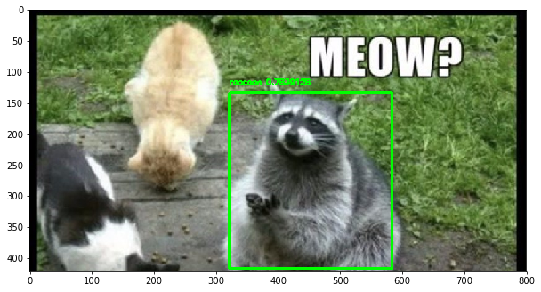
Visualizing Transfer Learning
4B
background - overview - goals - workflow - research - implement - visualize - summary - next steps

Slide 14
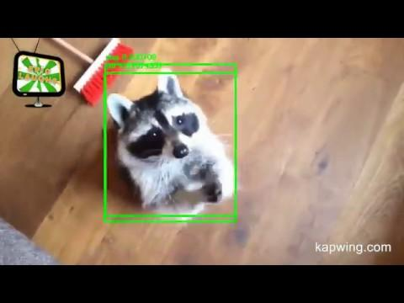
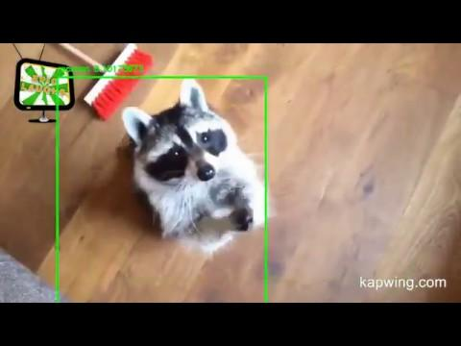
Visualizing Transfer Learning
4B
background - overview - goals - workflow - research - implement - visualize - summary - next steps
Side by side of YOLO detector (left) and Raccoon detector (right).

Slide 15
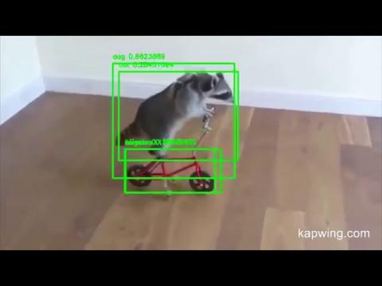
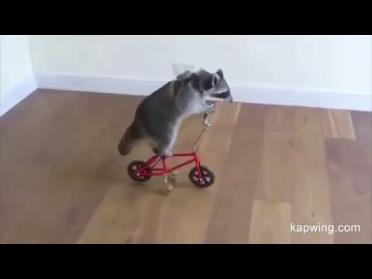
Visualizing Transfer Learning
4B
background - overview - goals - workflow - research - implement - visualize - summary - next steps
Side by side of YOLO detector (left) and Raccoon detector (right).

Slide 16
Summary
background - overview - goals - workflow - research - implement - visualize - summary - next steps
Started with image classification
Used object detection to bound multiple objects
Implemented transfer learning to add different classes
Training on Raccoon dataset led to a Raccoon detector

Slide 17
Next Steps
background - overview - goals - workflow - research - implement- visualize - summary - next steps
Use Transfer Learning to create model that can detect the original + trained classes
Measure speed of objects, number of objects, time of objects and analyze these statistics
Create online tool for ease of usability

Slide 18
Acknowledgements
Thank you for your time in listening to my presentation.
I would also like to acknowledge Infosys’ lab resources and Ms. Nidhi Tiwari for supporting me in my endeavors and for giving me the opportunity to explore computer vision, despite my having no background in it.

